Slide 1
Inheritance & Polymorphism
BACS2023
Object-Oriented Programming
Chapter 6 – Part 2

Slide 2
Learning Outcomes
At the end of this chapter, you should be able to
Explain polymorphism, dynamic binding, and generic programming.
Describe casting and explain why explicit downcasting is necessary.
Restrict access to data and methods using the protected visibility modifier.
Prevent class extending and method overriding using the final modifier.

Slide 3
1. Subtypes and Supertypes
A class defines a type.
  A type defined by a subclass is called a subtype.
  A type defined by its superclass is called a supertype.
The type of a variable is called its declared type.
A variable of a reference type can hold a null value or a reference to an object.
eg : int count;
GeometricObject obj;
Circle c1;
GeometricObject
Circle
Rectangle
Notes:
Every instance of a subclass is an instance of its superclass, but not vice versa.
e.g. Every circle is a geometric object but not every geometric object is a circle.

Slide 4
2. Polymorphism (1)
The term “polymorphism” is Greek meaning “of many forms”.
Polymorphism allows methods of the same name to behave differently within a class family.
  Polymorphism allows one method name to be used throughout the class family, with each class implementing the method in a way that is appropriate to its own purpose.

Slide 5
Polymorphism (2)
public class PolymorphismDemo {
public static void main(String[] args){
m(new GraduateStudent());
m(new Student());
m(new Person());
m(new Object());
}
public static void m(Object x) {
System.out.println(x.toString());
}
}
class GraduateStudent extends Student {
}
class Student extends Person {
public String toString() {
return "Student";
}
}
class Person extends Object {
public String toString() {
return "Person";
}
}
PolymorphismDemo
Output:
Student
Student
Person
java.lang.Object@1cfb549

Slide 6
Polymorphism (3)
A subclass is a specialization of its superclass
  Every instance of a subclass is an instance of its superclass, but not vice versa.
  Inheritance provides an is-a relationship, i.e. an object of a subclass can also be treated as an object of its superclass.
Therefore, you can always assign an instance of a subclass to a reference variable of its superclass type.
  This applies to parameter passing and assignment of objects to object reference variables (including array of objects).
GeometricObject
Circle
Rectangle
Circle c1;
Rectangle rect1
GeometricObject obj1 = c1;
GeometricObject obj2 = rect1;

Slide 7
Polymorphism (4)
public class PolymorphismDemo {
public static void main(String[] args){
m(new GraduateStudent());
m(new Student());
m(new Person());
m(new Object());
}
public static void m(Object x) {
System.out.println(x.toString());
}
}
class GraduateStudent extends Student {
}
class Student extends Person {
public String toString() {
return "Student";
}
}
class Person extends Object {
public String toString() {
return "Person";
}
}
Polymorphism enables the design and implementation of systems that are easily extensible and maintainable.
  New classes can be added with minimum or no modification.
  Programs process objects that share the same superclass as if they are objects of the superclass.
  Simplifies programming.

Slide 8
3. Polymorphism, Dynamic Binding and Generic Programming
public class PolymorphismDemo {
public static void main(String[] args) {
m(new GraduateStudent());
m(new Student());
m(new Person());
m(new Object());
}
public static void m(Object x) {
System.out.println(x.toString());
}
}
class GraduateStudent extends Student {
}
class Student extends Person {
public String toString() {
return "Student";
}
}
class Person extends Object {
public String toString() {
return "Person";
}
}
Method m takes a parameter of the Object type. You can invoke it with any object.
An object of a subtype can be used wherever its supertype value is required. This feature is known as parametric polymorphism.

Slide 9
Polymorphism, Dynamic Binding and Generic Programming
public class PolymorphismDemo {
public static void main(String[] args) {
m(new GraduateStudent());
m(new Student());
m(new Person());
m(new Object());
}
public static void m(Object x) {
System.out.println(x.toString());
}
}
class GraduateStudent extends Student {
}
class Student extends Person {
public String toString() {
return "Student";
}
}
class Person extends Object {
public String toString() {
return "Person";
}
}
When the method m(Object x) is executed, the argument x’s toString method is invoked.
x may be an instance of GraduateStudent, Student, Person, or Object.
Classes GraduateStudent, Student, Person, and Object have their own implementation of the toString method.
Which implementation is used will be determined dynamically by the JVM at runtime. This capability is known as dynamic binding.
PolymorphismDemo

Slide 10

Dynamic Binding
Suppose an object o is an instance of classes C₁, C₂, ..., C_{n-1}, and C_{n}, where C₁ is a subclass of C₂, C₂ is a subclass of C₃, ..., and C_{n-1} is a subclass of C_{n}.
  That is, C_{n} is the most general class, and C₁ is the most specific class.
In Java, C_{n} is the Object class.
If o invokes a method p, the JVM searches the implementation for the method p in C₁, C₂, ..., C_{n-1} and C_{n}, in this order, until it is found.
  Once an implementation is found, the search stops and the first-found implementation is invoked.

Slide 11
Method Matching vs. Binding
Matching a method signature and binding a method implementation are two different issues.
  Matching a method signature
    The declared type of the reference variable decides which method to match at compile time.
    The compiler finds a matching method according to parameter type, number of parameters, and order of the parameters at compilation time.
  Binding a method implementation
    A method may be implemented in several subclasses. The JVM dynamically binds the implementation of the method at runtime.
    The actual class of the object referenced by the variable decides which method implementation should be bound during runtime.
GeometricObject obj= new Circle(7.5);
System.out.println(obj.toString());

Slide 12
Generic Programming
public class PolymorphismDemo {
public static void main(String[] args) {
m(new GraduateStudent());
m(new Student());
m(new Person());
m(new Object());
}
public static void m(Object x) {
System.out.println(x.toString());
}
}
class GraduateStudent extends Student {
}
class Student extends Person {
public String toString() {
return "Student";
}
}
class Person extends Object {
public String toString() {
return "Person";
}
}
Writing methods which can be used generically for a wide range of object arguments.
  This is known as generic programming.
If a method’s parameter type is a superclass (e.g., Object), you may pass an object to this method of any of the parameter’s subclasses (e.g., Student or String).

Slide 13
4. Casting Objects – Implicit Casting
You have already used the casting operator to convert variables of one primitive type to another.
    double x=9; // implicit casting
    int y = (int) x; // explicit casting
Casting can also be used to convert an object of one class type to another within an inheritance hierarchy.
E.g. :
  Object o = new Student(); // Implicit casting
The statement Object o = new Student(), known as implicit casting, is legal because an instance of Student is automatically an instance of Object.

Slide 14
Casting Objects – Explicit Casting
E.g., you want to assign the object reference o to a variable of the Student type using the following statement:
Object o = new Student(); // Implicit casting
Student b = o; // Compilation error
  This is because a Student object is always an instance of Object, but an Object is not necessarily an instance of Student. Even though you can see that o is really a Student object, the compiler is not so clever to know it. To tell the compiler that o is a Student object, use an explicit casting.
The syntax is similar to the one used for casting among primitive data types - enclose the target object type in parentheses and place it before the object to be cast, as follows:
Student b = (Student)o; // Explicit casting

Slide 15
Downcasting Objects
Assigning an instance of a superclass to a reference variable of its subclass without an explicit cast is a compilation error (see Student.java).
Object o = new Student(); // Implicit casting
Student b =(Student) o; // Downcasting
  There is a need to (down)cast the reference stored in the superclass variable back to a reference of the subclass type.
When downcasting an object, a ClassCastException occurs if at execution time the object does not have an is-a relationship with the type specified in the cast operator.
  An object can be cast only to its own type or to the type of one of its superclasses.
  To check that the object is indeed an object of an appropriate subclass type, use the instanceof operator.

Slide 16
The instanceof Operator
Use the instanceof operator to test whether an object is an instance of a class:
GeometricObject myObject = new Circle();
. . . //some lines of code
// Perform casting if myObject is an instance of Circle
if (myObject instanceof Circle) {
System.out.println(“The circle diameter is “ +
((Circle)myObject).getDiameter());
. . .
}
else if (myObject instanceof Rectangle) {
…..
}

Slide 17
TIP
To help understand casting, you may also consider the analogy of fruit, apple, and orange with the Fruit class as the superclass for Apple and Orange.
  An apple is a fruit, so you can always safely assign an instance of Apple to a variable for Fruit.
  However, a fruit is not necessarily an apple, so you have to use explicit casting to assign an instance of Fruit to a variable of Apple.
  Are the following statements valid?
    Fruit f=new Apple();
    Apple app = new Apple();
    app = f;

Slide 18
Example:
Demonstrating Polymorphism and Casting
This example creates two geometric objects: a circle, and a rectangle
Invokes the displayGeometricObject method to display the objects.
The displayGeometricObject displays the area and diameter if the object is a circle, and displays area if the object is a rectangle.
Demo 6.5\TestPolymorphismCasting

Slide 19
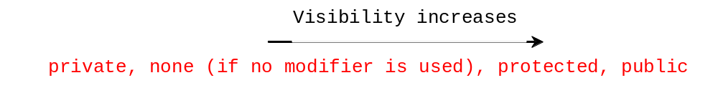
5. The protected Modifier (1)
The protected modifier can be applied on data and methods in a class.
A protected data or a protected method in a public class can be accessed by any class in the same package or its subclasses, even if the subclasses are in a different package.

Slide 20
The protected Modifier (2)
Protected data or methods in a class can be accessed by any of its subclass, e.g.
// In the superclass Rectangle.java
  protected double width;
  protected double height;
. . .
Rectangle
Cube
// In the subclass Cube.java
public Cube (double w, double h, double d){
  width = w;
  height = h;
  depth = d;
  }
Direct access to the
Superclass instance variable

Slide 21
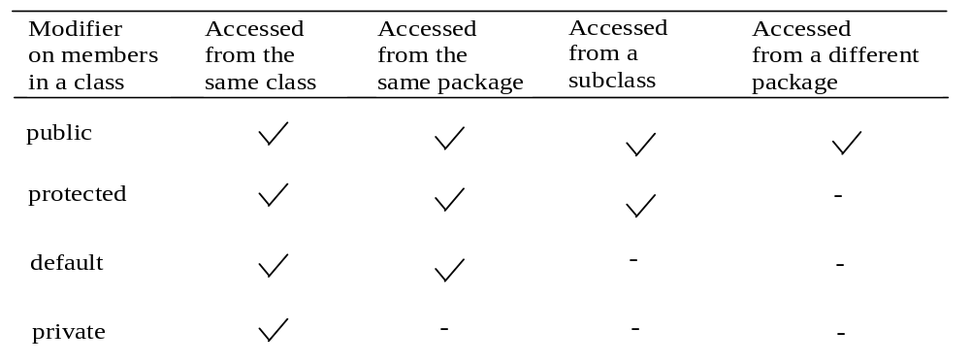
Accessibility Summary
Visibility modifiers are used to control where data and methods may be accessed.

Slide 22
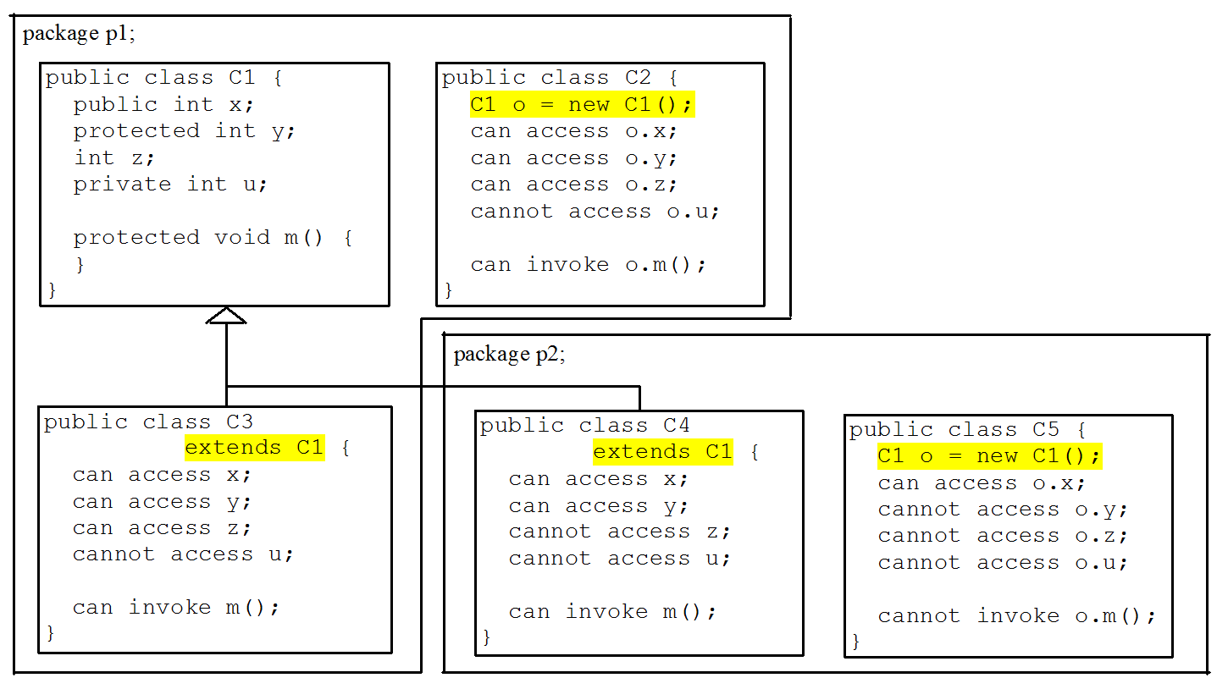
Visibility Modifiers

Slide 23
A Subclass Cannot Weaken the Accessibility
A subclass may override a protected method in its superclass and change its visibility to public.
However, a subclass cannot weaken the accessibility of a method defined in the superclass.
  E.g., if a method is defined as public in the superclass, it must be defined as public in the subclass.
public class Employee{
….
public void calculateSalary(){
…
}
}
public class Manager extends Employee{
….
public void calculateSalary(){
…
}
}

Slide 24
6. The final Modifier
The modifiers are used on classes and class members (data and methods), except that the final modifier can also be used on local variables in a method.
A final local variable is a constant inside a method.
public class Circle {
private double radius;
protected String color;
public Circle() { }
public Circle(double radius){
this.radius = radius; }
…….
public double getArea() {
final double PI = 3.142;
double area= radius * radius * PI;
return area;
}
}

Slide 25
The final Modifier
A final class cannot be extended:
final class Math {
...
}
The final variable is a constant:
final static double PI = 3.14159;
The final method cannot be overridden by its subclasses.
  public final double myFormula() { …}
MyMath
MyAlgebra

Slide 26
To Do
Review the slides and source code for this chapter.
Read up the relevant portions of the recommended text.
Do the tutorial and complete the remaining practical questions for this chapter.
  We shall selectively discuss them during class.

